Slide 1
MSCS621 Fall 2018 : Cloud Computing Project
by Harsha Kota

Slide 2
Objective
Develop a cloud application in a local cloud environment (Virtual Box +Vagrant + Docker), which can then deployed in a hybird cloud environment (AWS)
Both the environments use another cloud service that acts a service end point (IBM Bluemix Watson Assistant) which is responsible for its ability to understand and reply back using training data and machine learning logic.

Slide 3
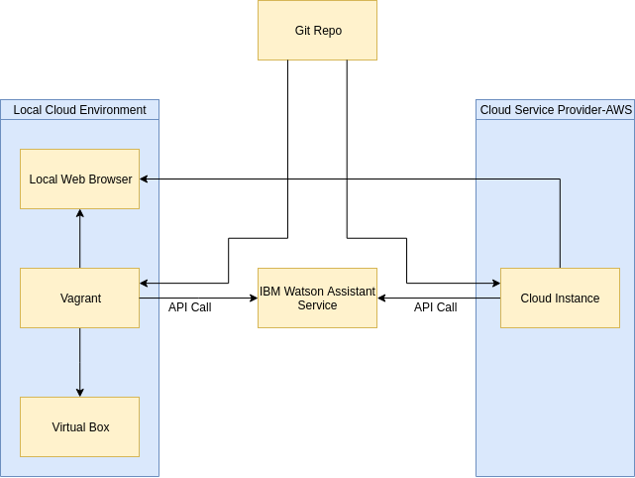
Architecture

Slide 4
Deployment Models
Local Cloud Environment
In order to create a local cloud environment, Vagrant was used to bring up a Ubuntu VM Server.
Since the application is Node.js based, and will run in a container, dependencies are installed. Docker, Node.js, etc.
Launching the application in a container using docker-compose will result in the application running at a specified port on the VM’s localhost.
As a Node.js application it provides a webpage where the application can be accessed.

Slide 5
Deployment Models
Hybrid Cloud Environment
In order to create a hybrid cloud environment, we use the Amazon Web Services to create a EC2 Ubuntu Instance that will act as our server.
Since the application is Node.js based, and will run in a container, dependencies are installed. Docker, Node.js, etc.
Launching the application in a container using docker-compose will result in the application running at a specified port on the AWS Instance.
As a Node.js application it provides a webpage where the application can be accessed.
This webpage in now on the web, and can be accessed using the Public IP Address exposed by the running EC2 Instance.

Slide 6
Communication
Both the deployment models rely on communicating with the IBM Watson Assistant Service that has been trained with training data we provided during its creation.
The IBM Watson Assistant exposes end point APIs that are called upon by the application to send user input and receive meaning replies from the machine learning logic.
These APIs are provided by the IBM Watson Assistant -More on this here IBM Watson APIs

Slide 7
Components
Server.js Starts the server at specified port
App.js Creates an assistant, sets up the client side endpoint POSt request that’s passed to the assistant, Updated on receiving reply back
Conversation.js Handles all display and behaviours of the conversation column of the app
Api.js Handless all interactions with the server
Common.js Hold functions that are used in multiple other modules
Payload.js Handles all display and behaviours of the conversation column of the app
Global.js Holds a function that initializes the ConversationPanel and PayloadPanel
Index.html Creates a webpage that allows user input and Conversation.js & Payload.js to load replies

Slide 8
Thank you
by Harsha Kota

